Slide 1
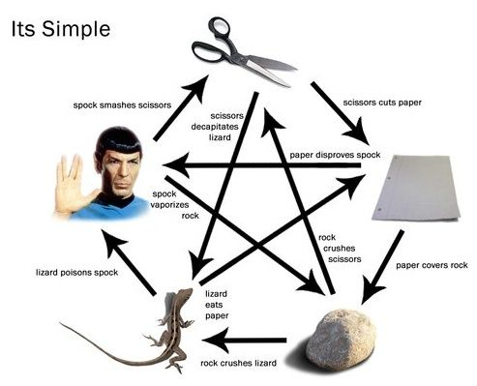
A little glimpse at Agent based Models in R
Lunchinators 3/30/2018

Slide 2
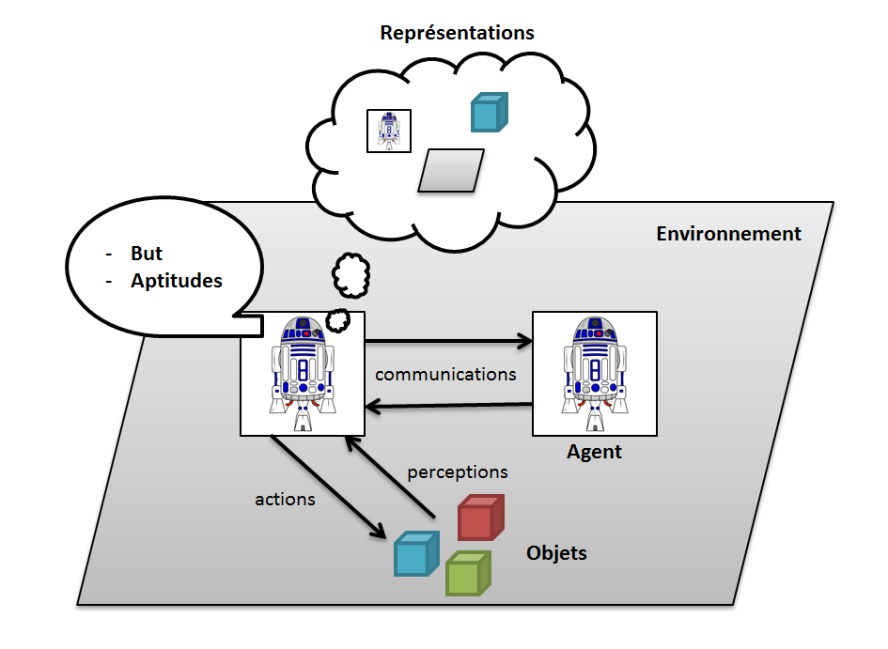
Agent Based Models
“An agent-based model (ABM) is a class of computational models for simulating the actions and interactions of autonomous agents (both individual or collective entities such as organizations or groups) with a view to assessing their effects on the system as a whole.”

Slide 3
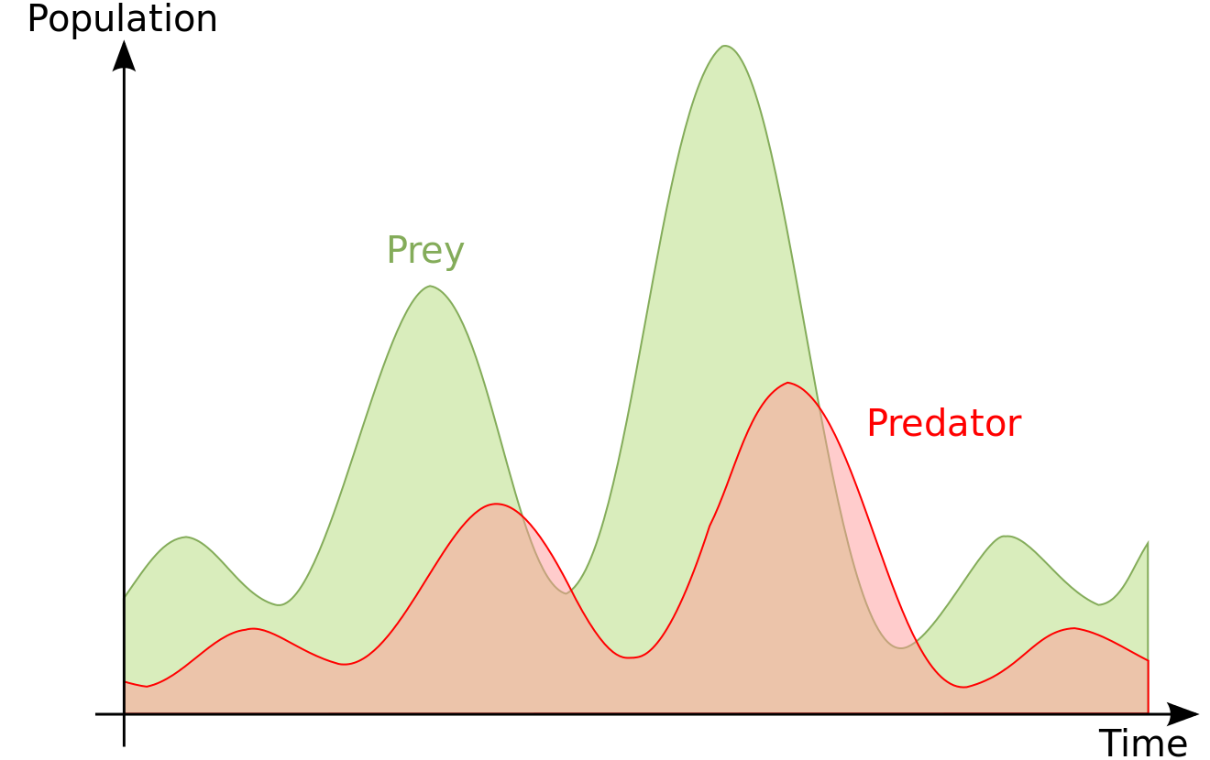

Agent Based Models
“An agent-based model (ABM) is a class of computational models for simulating the actions and interactions of autonomous agents (both individual or collective entities such as organizations or groups) with a view to assessing their effects on the system as a whole.”
Emergence Concept

Slide 4



Agent Based Models
Netlogo (R interactions through plugins and packages)
GAMA (can call R directly from the platform)
Repast (Never used it)

Slide 5

Agent Based Models

